Slide 1
East Birmingham & North Solihull Levelling Up Zone briefing July 18 2023

Slide 2
Background
Birmingham City Council has set out an ambitious but deliverable set of plans for the ongoing transformation of our city. These reflect the different opportunities and challenges our communities face across the city. Our Future City Plan, the Birmingham Innovation Quarter prospectus and the East Birmingham Inclusive Growth Strategy show clearly the different approaches to public and private investment that we need to deliver tangible benefits to residents.
For many parts of our city further improvements to public transport are key to improving access to jobs, services and opportunities to learn new skills. Private sector investment in the city centre and, increasingly, in the surrounding areas identified in the OFCP, needs to be accompanied by large scale public investment in transport if our communities in the east and north of the city in particular are going to benefit.
Over the past year we have been working closely, with colleagues in Solihull, to identify how the public investment needed could be unlocked. This work led to the development of the Levelling Up Zone proposal. The core idea is to bring together a group of sites in East Birmingham and use future business rate growth to help finance the infrastructure needed to make that growth happen, as the same time as reforming priority public services to ensure residents benefit. This proposal became a core element of the Deeper Devolution Deal and was accepted by government, subject to further detailed work.
Over the same period, government has developed its Investment Zone policy. This is aimed at landmark large sites that can drive productivity, R&D, regional GVA and supply chains in priority sectors, focusing on private sector investment.
Our aim is to ensure we use both to maximise the benefits to the city and our contribution to the wider West Midlands.

Slide 3
Investment Zones in more detail
Government published its Policy Prospectus in March 2023:
Geography: The West Midlands IZ covers the whole WMCA geography, but with identified sites benefiting from a range of incentives (see below)
Sector: Must focus on primary economic sector which aligns with a government defined priority sector, but opportunity to define broadly a genuine economic logic/intersection. WMCA Board agreed Advanced Manufacturing (June meeting), with a focus on the advanced engineering clusters identified in the West Midlands Plan for Growth.
Innovation Focussed: IZ must be innovation and R&D focussed with links to universities
Sites: Large, 200 ha, strategic, underdeveloped sites, avoiding displacement, demonstrating private sector investment, and meeting ‘levelling up’ to accommodate significant development/growth opportunities where funding and tax incentives applied
Process and Timetable: Propositions expected to be led by combined authorities, co-developed with local authorities and research institutions and DLUHC. Series of 5 Government gateways with likely announcements at the Autumn and Spring fiscal events.

Slide 4
Investment Zones in more detail
Incentives: Government is making available an additional £80m funding over five years, which can be flexibly applied between spending and five-year tax incentives. Government is allowing the following tax incentives to be funded from the £80m on up to 3 x 200 ha sites:
Stamp Duty Land Tax relief for land and buildings bought/developed for commercial use;
business rates 100% relief on newly occupied business premises;
Enhanced 100% first year Capital Allowance,
Enhanced Structures and Buildings Allowance Accelerated relief
Employer NIC
If it is not used to fund any tax incentives, then the £80m is to be 40:60 between revenue and capital. This would allow, for example, skills provision for an anchor investor or employment services to be funded to help people into jobs in the relevant sector. The capital element could fund infrastructure (although it is a very small amount). If the full tax incentives are taken up, then Government will make £35m available on a similar basis.
Business Rate Retention: Government have said that up to two sites can be designated to retain 100% of business rate growth above baseline for 25 years above baseline, free from resets, to be reinvested in the primary sector. This does not preclude site infrastructure.

Slide 5
Levelling Up Zones (aka Growth Zones)
Geography and sites: In the DDD Government agreed to work with the West Midlands to develop up to six ‘Levelling Up Zones or Growth Zones.’ Government seeking large, single sites, as it makes operating the business rate retention system easier although this does not reflect the reality of the West Midlands geography and to work Levelling Up Zones needs to include groups of smaller sites and a larger number of sites.
Business rate retention: Government have offered 25 year business rate retention above baseline on the same basis as for Investment Zones. This is key to the zones working, as the aim is to use the BRR to finance the additional infrastructure needed to drive growth and benefit local people.
Next steps: Negotiation ahead with government on rules around LUZs such as how many sites can harness business rate growth retention
Emerging West Midlands proposition:
EBNS
Metro extension corridor (Dudley and Sandwell)
Walsall (Willenhall rail / road corridor)
Wolverhampton Green Innovation Corridor
Possibly Coventry sites, depending on IZ and Gigapark

Slide 6
Purpose
East Birmingham & North Solihull Levelling Up Zone
Pillars of interventions
This is our proposal for a new approach for East Birmingham and North Solihull. Holistic intervention in the area will be underpinned by a 25-year business rates retention model that will unlock significant public and private investment in infrastructure to power jobs, new commercial development and housing.
Through an integrated plan for the area as a whole we will increase employment opportunities and improve outcomes including for health in an area with the largest concentration of deprivation in the UK.
Our approach has been developed jointly by WMCA, Birmingham City Council and Solihull Metropolitan Borough Council. There is clear alignment and agreement across the Mayor and Local Authorities, which crosses across party lines to enable delivery at pace in one of the UK’s priority areas.
The proposals build on over a decade of work by the East Birmingham Board, North Solihull Partnership and a wide range of partners.
The integrated approach will be a demonstrator for government’s levelling up commitment, bringing together a suite of interventions designed to deliver local transformation. Interventions revolve around three pillars of work:
Governance and Capacity. Building local capacity to deliver and oversee interventions, through a bespoke governance model.
Infrastructure and Regeneration. Effective and high-impact public investment unlocked in order to effectively crowd in private sector investment at scale needed to drive and sustain growth, led by specific sites and improved transport connectivity key to faster and deeper growth
Public Services. Improved public services will ensure local people can benefit from new jobs, and that businesses have a ready supply of skilled people, and key indicators for people’s health and well-being are improved

Slide 7
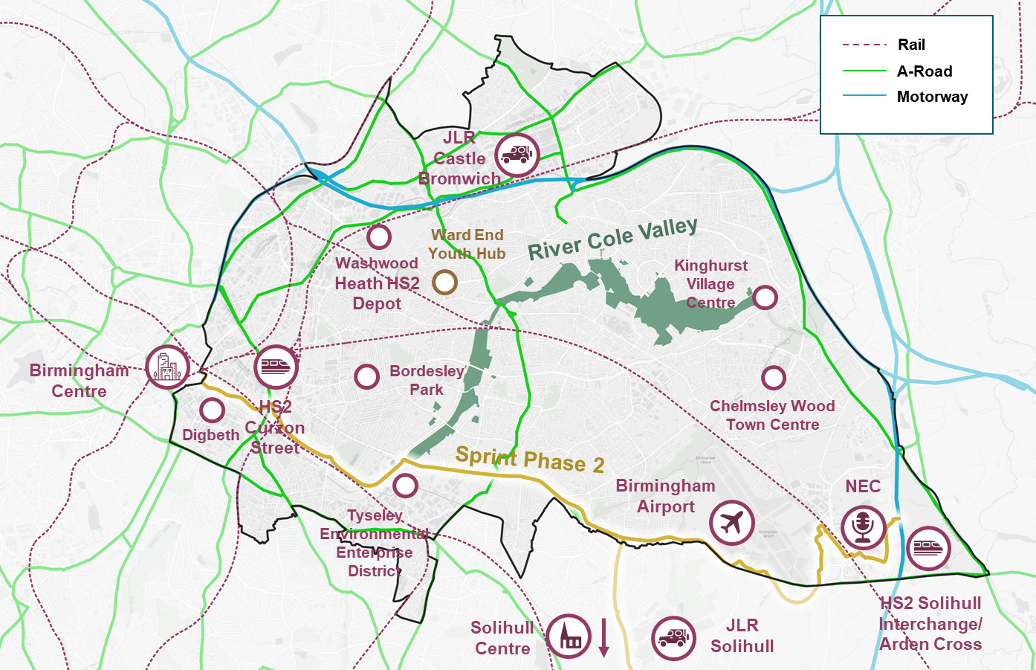
East Birmingham & North Solihull: shared opportunities
East Birmingham and North Solihull (EBNS) is a young, vibrant, socially, culturally and economically diverse part of the West Midlands with a population of around 375,000, larger than most UK cities. In the west the area connects the HS2 station at Curzon Street in Birmingham City centre with HS2 Interchange station at the NEC and airport to the east. This puts the region at the heart of potential growth opportunities and a unique opportunity within the UK to leverage growth to improve outcomes. Supporting this wider transport corridor, between the two stations, will be a key objective of the Levelling Up Zone.
Historically, East Birmingham and North Solihull have been closely tied, with much of North Solihull originally established as a post-war expansion of the city. The local economy and community are integrated across the administrative boundary – a focus on opportunities and infrastructure across the area as a whole will bring most benefits to the 25 wards of EBNS.
Areas of growth and high potential

Slide 8
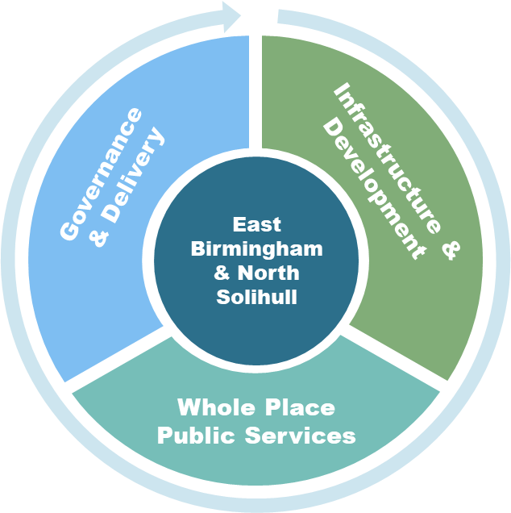
8
A new co-ordinated approach: 3 pillars of intervention
To deliver the growth needed and ensure that this delivers for local people will require a new approach to both public capital investment and public services. Why? Because we need to lever in more of the proceeds of private sector growth to fund infrastructure which in turn will accelerate further private investment and growth. And we need to ensure that local services are more integrated and more effectively targeting those who, with the right help, could benefit in terms of health and wages thereby generating a multiplier growth circle.
What this will involve:
Governance and Capacity. Building local capacity to deliver and oversee interventions, through a bespoke governance model covering local delivery vehicles
Infrastructure and Regeneration. Effective and high-impact public investment unlocked in order to effectively crowd in private sector investment at scale needed to drive and sustain growth, led by specific sites and improved transport connectivity key to faster and deeper growth
Public Services. Improved public services will ensure local people can benefit from new jobs, and that businesses have a ready supply of skilled people, and key indicators for people’s health and well-being are improved, with a particular focus on Health, Skills and Early Years Intervention. This will include maximising social value and the role of public sector institutions and anchors in economic development across EBNS.

Slide 9
A new co-ordinated approach
Oversight via new EBNS board
Shared data, capacity, and capability across LUZ
Closer collaboration between local partners through governance structures
Site-level co-ordination and capacity to support private sector investment in employment sites
High quality and consistent evidence work across EBNS
Ultimate value of public spending by increasing efficacy of services and intervention
Increased private sector investment in major employment sites
Monitoring and evaluation
Governance & delivery authority/resourcing
LA specific delivery arrangements
Capacity and data sharing
Strategic transport, regen and green infrastructure investment
Revenue investments in region
Delivering new employment sites in line with planning, delivery and spatial inclusive growth principles
Improved access to employment and learning
Cleaner air and reduced carbon emissions,
Increased land values and economic growth
Access to quality green space
Carbon reduction
Bio-diversity gain / offset
Enabling infrastructure and regeneration investment at scale
TIF mechanism for investment
Aligned placemaking framework
Pooled funding for resident services
Reduced duplication and overlaps in public service provision
Public sector land ownership consolidation
Improved educational attainment
Reduced unemployment – especially youth unemployment
Reduced economic inactivity
Better health outcomes
Improved physical and mental health
Reduced maternal and infant mortality rates
Decrease in poverty indicators – foodbank use, in-work UC claimants, earning below RLW
Admin and governance of collaborating partners
Multi-year integrated public services
Local data collation and sharing between services
Physical co-location of services
Pillar
Delivery mechanisms
Outputs
Outcomes

Slide 10
Regeneration investment
The second pillar of the proposed EBNS LUZ focuses on physical regeneration and improvements to enabling infrastructure, looking to address poor physical connectivity.
Following the West Midlands Trailblazer Devolution deal, a series of new mechanisms have been available to local government to deliver against the concept of Levelling Up Zones, a key ask from local authorities within the West Midlands. The most important of the entailed levers is the ability to establish a number of Growth Zones across WMCA, which would allow the designation of local (employment-oriented) sites where 100% of business rates could be retained within a 25-year window.
These Growth Zones will be subject to business cases. Current expectations are that there is no cap on retained rates, but given the accumulated value across multiple levelling up zones in the West Midlands, this may change.
Reinvestment from Growth Zones will go towards socioeconomic infrastructure that benefits East Birmingham and North Solihull, with a clear narrative linking interventions, even outside the defined EBNS boundary, to socioeconomic benefit in the area.
What might it fund?
Delivery of a comprehensive set of capital interventions:
Sprint connectivity - Improved bus travel timetable predictability (through an expansion of dedicated bus lanes and services)
Leveraging existing transport assets (by investing in better mode integration at key interchanges), and securing space for future transport interventions (e.g. VLR or Metro)
Major site infrastructure, inc Arden Cross, Chelmsley Wood, Kingshurst
Site assembly and enabling works on key employment sites
Investing in active travel (walking and cycling)
Further investment in parks and green space / corridors
Perhaps with revenue investment to enable:
Skills and social infrastructure
Community investment and hyper-local spending
Maintenance and upkeep of public spaces and commercial centres

Slide 11
Regeneration – site principles
Identifying sites for business rate retention (BRR) involves identifying sites with high potential for commercial development. The ideal site for BRR is one where rateable values will increase throughout the retention period, maximising the potential for business rate uplift through which infrastructure investment can be financed.
Initial sites were identified for EBNS from existing master-planning exercises and employment land availability assessments. They were compiled for initial LUZ consideration, and for Autumn 2022 Investment Zone deliberations. They have been further refined and assured over time, based on considerations including:
Deliverability – site status, remediation and infrastructure requirements
Potential for uplift – site size, current use and potential uses
Potential to crowd in private sector investment – drawing on local knowledge, potential investors and local partners
Alignment with wider inclusive growth principles – with local planning frameworks
The expectation isthat in both East Birmingham and North Solihull, potentially upwards of half a billion pounds of investment finance could be serviced through rate retention over the next 25 years.

